Slide 1

Valid Arrangement of Pairs
This presentation covers the problem of identifying valid arrangements of pairs. It introduces the problem statement, walks through an example, and outlines the key steps to solve it. The approach involves handling key mapping, managing node degrees, and traversing the graph. Relevant constraints and assumptions are also discussed, along with a sample coding implementation.

Slide 2

Problem Statement
The task is to arrange a set of pairs, where each pair represents a starting and ending point, in a valid sequence. A valid arrangement ensures that the ending point of one pair always matches the starting point of the next pair.
Input
Output
A 2D integer array called "pairs" where each inner array represents a pair [start, end].
A valid arrangement of the input pairs, returned as a 2D integer array.

Slide 3

Input and Output Example
Let's consider an example: Input: pairs = [[5, 1], [4, 5], [11, 9], [9, 4]]
Input pairs
[5, 1]
[4, 5]
[11, 9]
[9, 4]
Valid Arrangement
[11, 9]
[9, 4]
[4, 5]
[5, 1]

Slide 4




Approach
To solve this, we can use a recursive approach. We start by finding the first pair where the starting value is not already used as an ending value in any other pair. Then, we recursively find the next pair that starts with the previous pair's ending value.
Find the starting pair
Find the first pair where the start value is not an ending value.
Recursive step
Find the next pair that starts with the previous pair's ending value. Repeat until a valid arrangement is found.
Return arrangement
Return the found valid arrangement of pairs.

Slide 5

Constraints and Assumptions
The input will always contain a valid arrangement. The goal is to find one of these valid arrangements, and there may be multiple possible solutions. The input pairs are guaranteed to be valid in that there exists a valid arrangement of pairs. This assumption simplifies the problem by ensuring that a solution always exists.
1
Input Constraint
2
Assumption
The pairs will be generated in a way that ensures a valid arrangement is possible.
There will always be at least one valid arrangement of pairs.

Slide 6
Coding:
#include <stdio.h>
#include <stdlib.h>
typedef struct Node {
int value;
struct Node* next;
} Node;
Node* createNode(int value) {
Node* newNode = (Node*)malloc(sizeof(Node));
newNode->value = value;
newNode->next = NULL;
return newNode;
}
void addEdge(Node** list, int index, int value) {
Node* newNode = createNode(value);
newNode->next = list[index];
list[index] = newNode;
}
int findKey(int* keys, int size, int key) {
for (int i = 0; i < size; ++i) {
if (keys[i] == key) return i;
}
return -1;
}
void validArrangement(int pairs[][2], int size) {
int mapSize = 0, startNode = pairs[0][0];
int keys[100], inDegree[100] = {0}, outDegree[100] = {0};
Node* adjacencyList[100] = {NULL};
int path[100], pathSize = 0;
for (int i = 0; i < size; ++i) {
int start = pairs[i][0], end = pairs[i][1];
int index = findKey(keys, mapSize, start);
if (index == -1) keys[mapSize++] = start, index = mapSize - 1;
addEdge(adjacencyList, index, end);
outDegree[index]++;
index = findKey(keys, mapSize, end);

Slide 7
if (index == -1) keys[mapSize++] = end, index = mapSize - 1;
inDegree[index]++;
}
for (int i = 0; i < mapSize; ++i) {
if (outDegree[i] - inDegree[i] == 1) startNode = keys[i];
}
int stack[100], stackSize = 0;
stack[stackSize++] = startNode;
while (stackSize > 0) {
int currentNode = stack[stackSize - 1], index = findKey(keys, mapSize, currentNode);
if (adjacencyList[index]) {
stack[stackSize++] = adjacencyList[index]->value;
Node* temp = adjacencyList[index];
adjacencyList[index] = adjacencyList[index]->next;
free(temp);
} else {
path[pathSize++] = stack[--stackSize];
}
}
for (int i = pathSize - 1; i > 0; --i) {
printf("[%d, %d] ", path[i], path[i - 1]);
}
printf("\n");
}
int main() {
int pairs[][2] = {{5, 1}, {4, 5}, {11, 9}, {9, 4}};
validArrangement(pairs, sizeof(pairs) / sizeof(pairs[0]));
return 0;
}

Slide 8
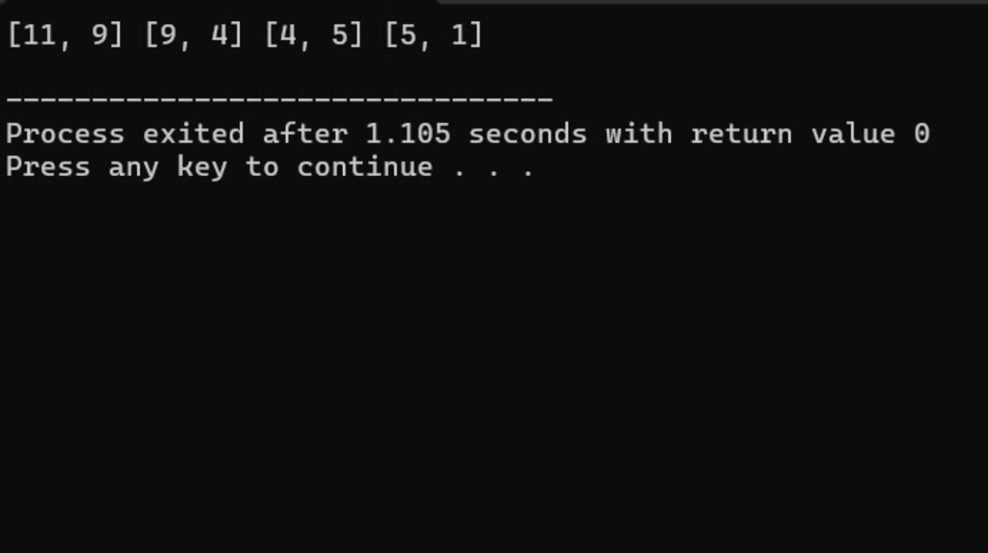
Output:

Slide 9




Conclusion
This presentation has explored the problem of finding a valid arrangement of pairs. We discussed the problem statement, explored an example, and outlined a recursive approach to solve it. Understanding these concepts provides a solid foundation for working with paired data and solving similar arrangement problems.
Valid Arrangement
The problem involves finding a sequence of pairs where the ending point of one pair always matches the starting point of the next.
Recursive Approach
The solution uses a recursive approach to find the first pair and then continues finding subsequent pairs that meet the criteria.
Problem Constraints
The input is guaranteed to have at least one valid arrangement, simplifying
the problem.

